Slide 1
Using After School Activities To Reduce Crime
Zachary Sorenson
Connor Mattes

Slide 2
Introduction
Motivation
General LP
Optimization
Minimize: Distance from crimes
Maximize: Distance from other after school program
Additional Considerations:
Types of crimes committed by teenagers
Placement of new programs

Slide 3
Data
General Data Sets
This dataset includes criminal offenses in the City and County of Denver for the previous five calendar years plus the current year to date.(2015-2018)
Locations of varied programs (chorale singing, summer day camp, junior success tutoring, etc.) (2016)
“Cleaned” Data Sets
OpenRefine
Reduced to dates to Jan. 2016 – Dec. 2016 for first data set
Reduced to Top 3 Crimes committed by teenagers in second data set:
Theft/Larceny, Vandalism, Alcohol Offenses (Source: https://www.globalyouthjustice.org)

Slide 4
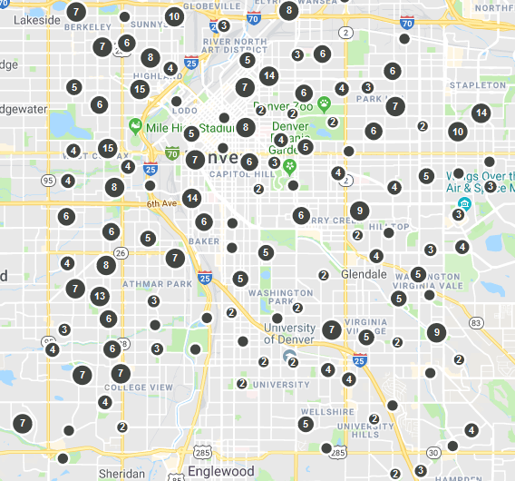
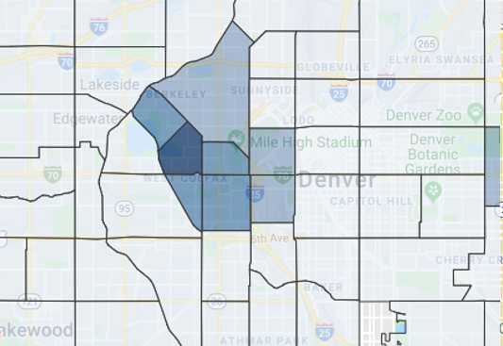
Visual Representations
Big Picture
After School Programs
Crime Density

Slide 5
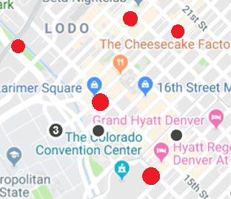
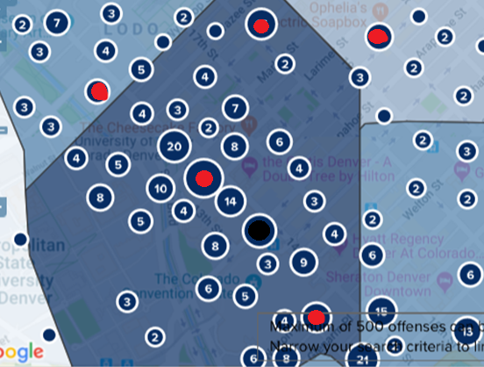
Visual Representations
After School Programs
Crime Density

